Slide 1
SOC Analyst Career and CompTiA CySA+ Certification
WiCyS and CyberHawk Security
Illinois Institute of Technology
October 22, 2020
Notes:
Harshini

Slide 2
Hello everyone and welcome!
We are WiCyS and CyberHawk Security at Illinois Tech.
Notes:
Harshini & John

Slide 3
Agenda
What is a SOC Analyst
Q&A
What is CySA+
Notes:
John

Slide 4
What is a SOC Analyst?
SOC stands for Security Operations Center. Within the SOC, there are a team of security professionals and SOC analysts.
A SOC Analyst works with the team to review and monitor an organization’s network traffic and to identify any signs of malicious activity.
They also suggest improvements to remediate threats on a network.
The SOC Analyst career is a great entry-level role! Many cybersecurity professionals have started their career in this way.
Notes:
Harshini

Slide 5
Why are SOC Analysts important?
SOC Analysts are needed for their critical thinking capabilities. They make the call for when potentially malicious activity is a real threat or not.
They provide research and analysis into security incidents
They help the incident response teams in developing an incident response plan in the event of an incident.
Notes:
Harshini

Slide 6
Average Pay and Job Titles
SOC Analyst Salary – $47K to $79K
Job Titles Associated with the responsibilities of a SOC Analyst -
Threat Intelligence Analyst
Vulnerability Analyst
Cybersecurity Analyst
Information Security Analyst/Administrator
Security Administrator
Notes:
John

Slide 7
A day in the life
Look through network traffic
When an analyst starts their shift, they log into a SIEM system that collects and displays network traffic for the appliances on the network.
Record observations
When an analyst find any malicious behavior on the network, they record the case they found in a ticketing system.
Escalate Alerts when Needed
After cases are recorded, tickets are escalated to senior team members based on the ticket severity level
Notes:
John

Slide 8
Network Traffic Analysis
Looking through network traffic logs
The SIEM system (Kibana) may record traffic for a firewall, for example.
If we notice an external IP address trying to connect to our systems, we can conduct research on that IP address to determine if it is malicious or not.
Virustotal.com
Talosintelligence.com
Websites to check for malicious URLs or IP addresses or Files
Notes:
Harshini

Slide 9
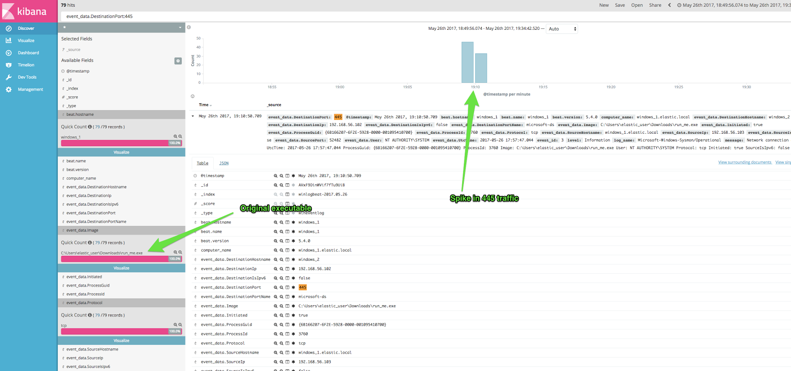
Network Traffic Analysis
Notes:
Harshini

Slide 10
Case Creation
Finding a malicious event
When an analyst finds any malicious behavior on the network, they record the case they found in a ticketing system.
FOR EXAMPLE (in the case of malicious IP traffic):
Summarize the event. Determine its severity.
Describe the event in detail. How do you know the traffic is malicious? How did you find out it was malicious? Where is the traffic coming from and going to?
Record the name of the appliance(s) affected and the IP addresses involved
Notes:
Harshini

Slide 11
Escalations
Reporting malicious activity
After cases are recorded, tickets are escalated to senior team members based on the ticket severity level.
For cases that you believe to be high-severity cases, you must escalate them to a higher-level analyst. They will then determine if further action needs to be taken.
Notes:
Harshini

Slide 12
Top Skills for SOC Analysts
Network defense
Ethical hacking
Incident response
Computer forensics
Reverse engineering
Notes:
John

Slide 13
Top Certifications for SOC Analysts
CompTIA CySA+
CompTIA Sec+
EC-Council Certified SOC Analyst (CSA)
Cisco Certified CyberOps Associate
Notes:
John

Slide 14
What is CySA+ Certification?
CompTIA is a very well known non-profit organization that issues professional certifications for IT industry.
CompTIA Cybersecurity Analyst (CySA+) is an IT workforce certification that applies behavioral analytics to networks and devices to prevent, detect and combat cybersecurity threats through continuous security monitoring.
It focuses on the candidates ability to not only proactively capture, monitor, and respond to network traffic findings, but also emphasizes software and application security, automation, threat hunting, and IT regulatory compliance, which affects the daily work of security analysts.
Notes:
Anushka

Slide 15
What is CySA+ Certification?
You get this certification by passing ONE online exam.
Maximum of 85 multiple choice and performance-based questions
165 mins exam
To pass: get at least a score of 750 (on a scale of 100-900)
A certification that emphasizes hands-on practical skills and focuses on the latest trends and techniques
Special discount for students
Notes:
Anushka

Slide 16
Benefits of taking the exam?
Attract Employers and Recruiters
The CompTIA CySA+ certification is widely considered one of the essential foundational security analyst certifications in the cybersecurity industry today.
Access to Jobs You Want
Security Analyst Threat Intelligence Analyst Application Security Analyst Security Engineer Incident Response Threat Hunter Compliance Analyst
Respected Standards
CompTIA CySA+ meets the ISO 17024 standard and is approved by U.S. Department of Defense to fulfill Directive 8570.01-M requirements, compliant with FISMA, and more!
Notes:
Anushka

Slide 17
What skills will you learn? What’s on the exam?
Threats, Attacks, and Vulnerability Management
Utilize and apply proactive threat intelligence to support organizational security and perform vulnerability management activities
Software and Systems Security
Apply security solutions for infrastructure management and explain software & hardware assurance best practices
Compliance and Assessment
Apply security concepts in support of organizational risk mitigation and understand the importance of frameworks, policies, procedures, and controls
Security Operations and Monitoring
Analyze data as part of continuous security monitoring activities and implement configuration changes to existing controls to improve security
Incident Response
Apply the appropriate incident response procedure, analyze potential indicators of compromise, and utilize basic digital forensics techniques
Notes:
Anushka

Slide 18
Sample Study Materials
Practice Tests
There are various practice tests out there that you can use to test your skills before taking the real exam. This will help you understand your strengths and weaknesses.
CySA+ Courses
Take an online course on a well-known platform such as LinkedIn Learning or Coursera.
Textbooks
Learn what it takes to pass the exam using a from a CySA+ textbook. Textbooks will often cover all the main skills you need to pass the certification.
Official CompTIA Prep
Study materials from the makers of the exam itself. Only downside… it’s expensive.
Notes:
Anushka
Darril Gibson - authored, coauthored, or contributed to more than 35 books on CompTIA A+, Network+, Security+, Windows Server, Windows 7, SQL Server, and more
Pocket Prep- different prices for different plans
LinkedIn Learning-

Slide 19
Practice Questions
One of the best way to prepare for the Security+ exam is by practicing exam questions.
Notes:
Harshini

Slide 20
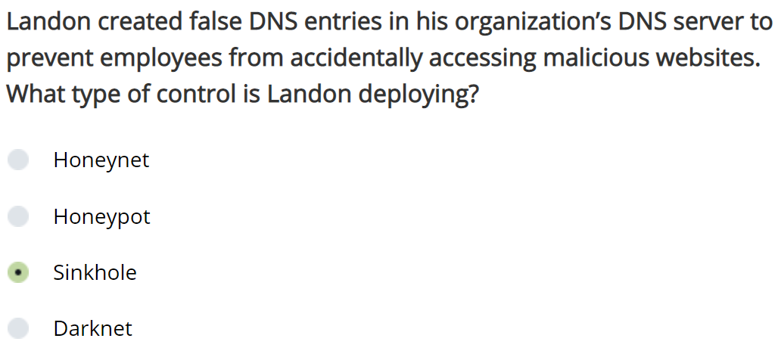
Threats, Attacks, and Vulnerability Management
Explanation:
A DNS sinkhole provides false responses to queries for malicious websites to prevent users from visiting those sites.
A honeynet is a decoy network containing one or more honeypots.
A honeypot is a separate purposely-vulnerable machine that baits attackers and examines the techniques they use to gain a better understanding for how to secure other machines.
The darknet is a restricted access computer network that is used for illegal peer-to-peer file sharing.
Notes:
John

Slide 21
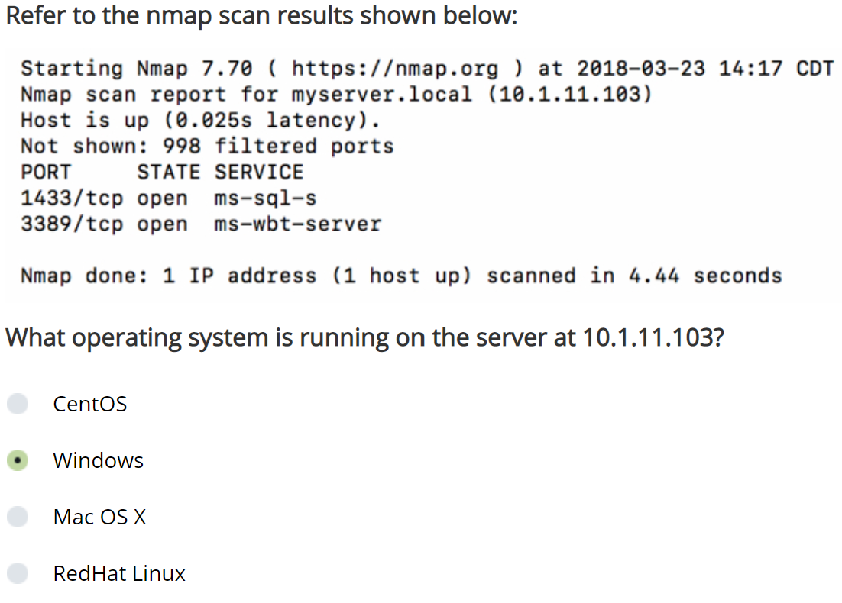
Software and Systems Security
Explanation:
This server is listening on port 3389, which is used by the Remote Desktop Protocol (RDP) on Windows systems.
The “ms” in “ms-sql-s” and “ms-wbt-server” indicates that these are Microsoft services, and such services are generally only run on Windows systems.
Notes:
John

Slide 22
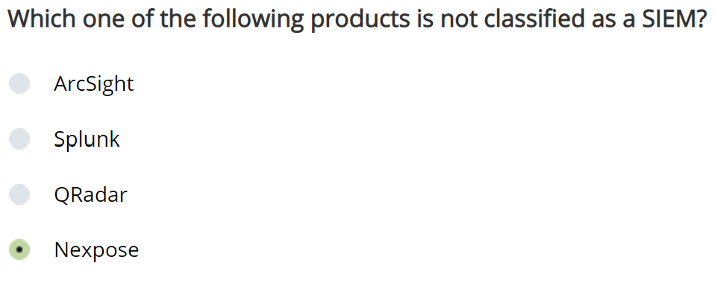
Security Operations and Monitoring
Explanation:
Nexpose is a vulnerability scanner. Splunk, ArcSight, and QRadar are all examples of security information and event managers (SIEM).
Notes:
John

Slide 23
Thanks!
Any questions?
You can find us at:
wicys@iit.edu
cyberhawks.iit.edu
Notes:
John

